Slide 1
Applied Data Science 2
Dr Ashley SpindLer
Semester B, 2022

Slide 2
Lecture 4 - Outcomes
Understand how Structured Streaming works in a practical sense
Understand the use cases of Spark Streaming
Demonstrate an example of Structured Streaming

Slide 3
Spark Streaming

Slide 4
Structured Streaming
Suppose we have a DataFrame

Slide 5
Structured Streaming
Suppose we have a DataFrame
Query

Slide 6
Structured Streaming
Suppose we have a DataFrame
Result
Query

Slide 7
Structured Streaming
What happens if we get new data?

Slide 8
Structured Streaming
What happens if we get new data?
…
…
…
…
…
…

Slide 9
Structured Streaming
What happens if we get new data?
We need a way to only process the new data, not the entire dataset.
…
…
…
…
…
…

Slide 10
Structured Streaming
…
…
…
…
…
…
Packets of data are treated as new rows

Slide 11
Structured Streaming
…
…
…
…
…
…
Likely that we have batches of data > multiple rows

Slide 12
Structured Streaming
Result
Query
…
…
…
…
…
…

Slide 13
Structured Streaming
Result
Query
…
…
…
…
…
…
Result
Query

Slide 14
Structured Streaming
Result
Query
…
…
…
…
…
…
Result
Query

Slide 15
Why Streaming?
Continuous evaluation of new data in a production environment
Whether we want to update a model or result, or send out some form of alert or notification

Slide 16
Example Use Cases
Fraud detection in banking transactions
Monitoring social media trends
Tracking customer behaviour during a sale

Slide 17
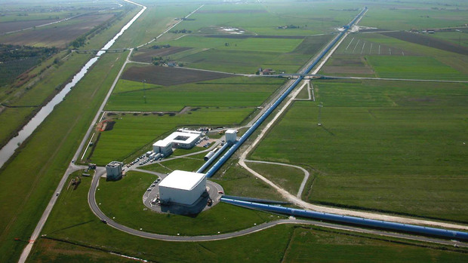
Example Use Cases

Slide 18
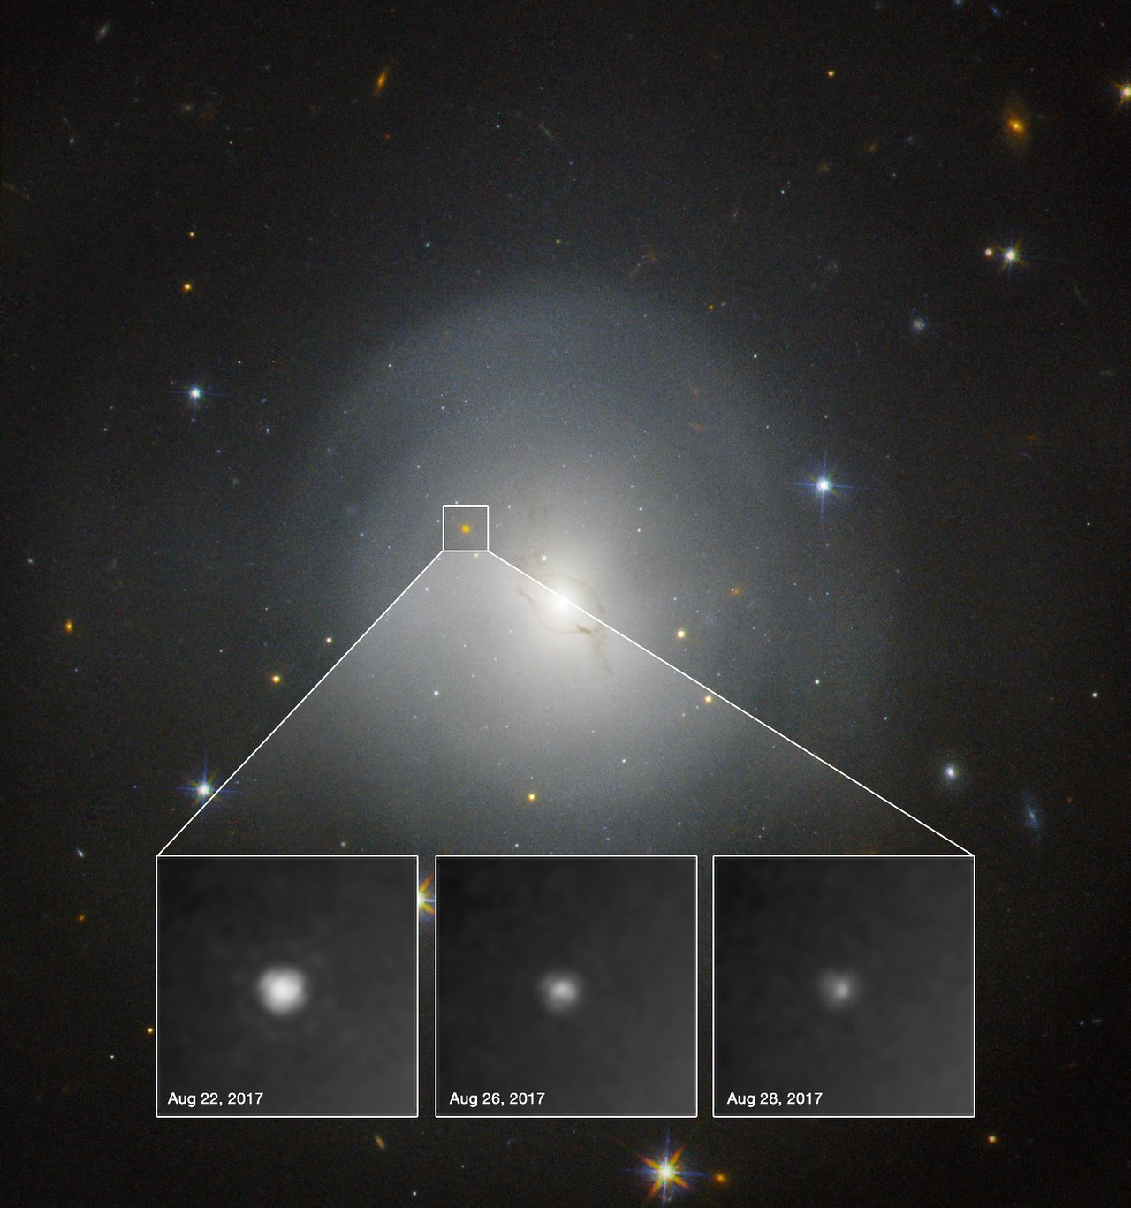
Example Use Cases

Slide 19
Live Demo

Slide 20
Questions???

